Slide 1
Binary Trees - III
Lecture # 16

Slide 2
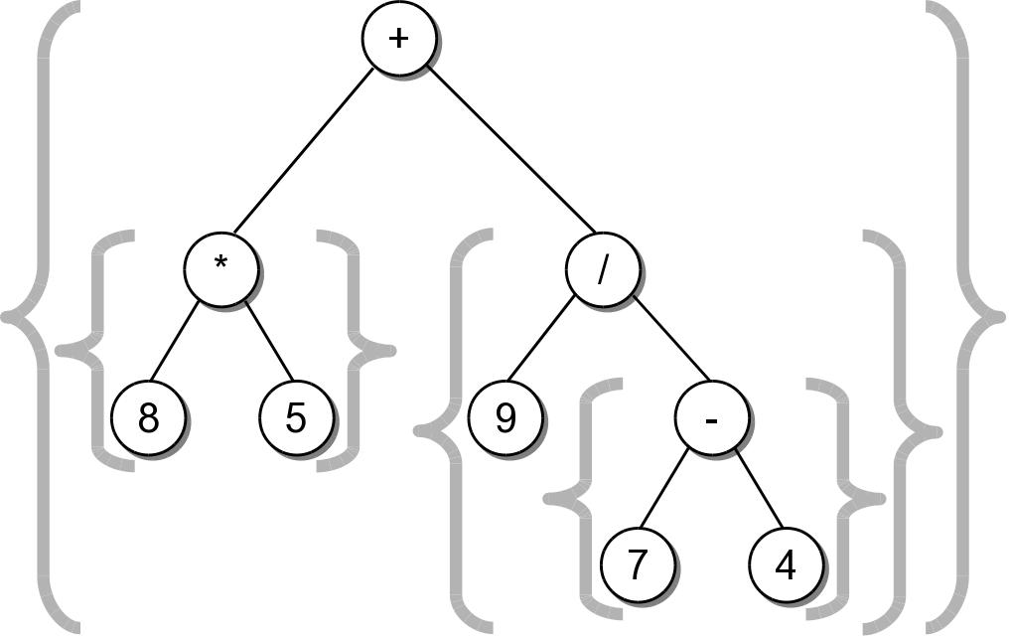
String Representation
The result was not correct because required parentheses were missing.
Can easily create a fully parenthesized expression.
((8 * 5) + (9 / (7 - 4)))
Class activity to implement this __str__() method.

Slide 3
Expression Tree Implementation
exptree.py
class ExpressionTree :
# ...
def _build_string( self, tree_node ):
# If the node is a leaf, it's an operand.
if tree_node.left is None and tree_node.right is None :
return str( tree_node.element )
# Otherwise, it's an operator.
else :
exp_str = '('
exp_str += self._build_string( tree_node.left )
exp_str += str( tree_node.element )
exp_str += self._build_string( tree_node.right )
exp_str += ')'
return exp_str

Slide 4
Expression Tree Construction
An expression tree is constructed by parsing the expression and examining the tokens.
New nodes are inserted as the tokens are examined.
Each set of parentheses will consist of:
an interior node for the operator
two children either single valued or a subexperssion.

Slide 5
Expression Tree Construction
For simplicity, we assume:
the expression is stored in a string with no white space.
the expression is valid and fully parenthesized.
each operand will be a single-digit or single-letter variable.
the operators will consist of +, -, *, /, %

Slide 6
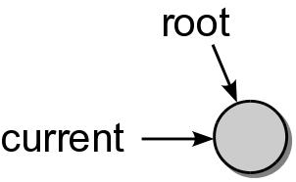
Expression Tree Construction
Consider the expression (8*5)
The process starts with an empty root node set as the current node:
The action at each step depends on the current token.

Slide 7
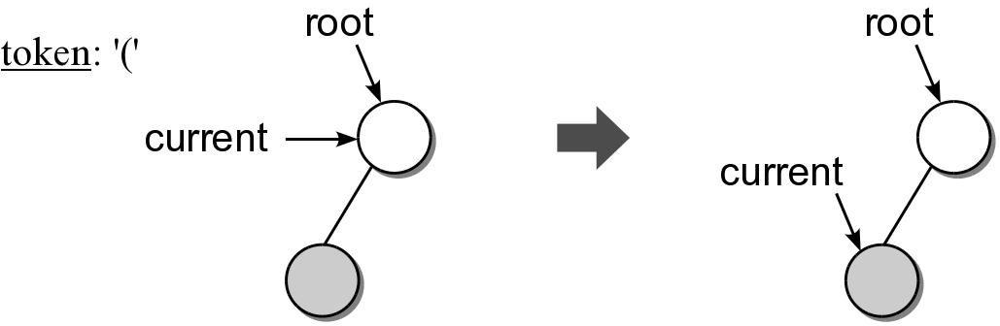
Expression Tree Construction
When a left parenthesis is encountered: (8*5)
a new node is created and linked as the left child of the current node.
descend down to the new node.

Slide 8
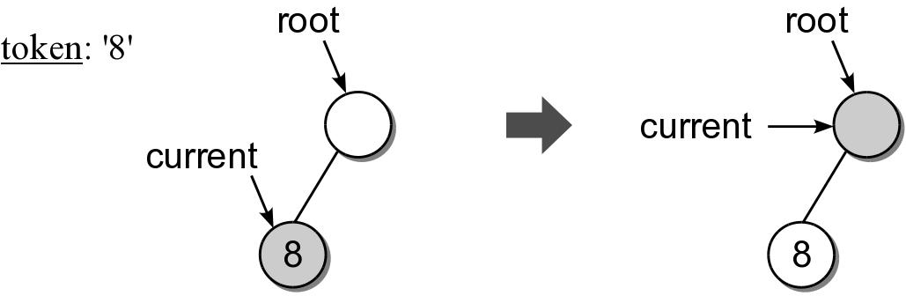
Expression Tree Construction
When an operand is encountered: (8*5)
the data field of the current node is set to contain the operand.
move up to the parent of current node.

Slide 9
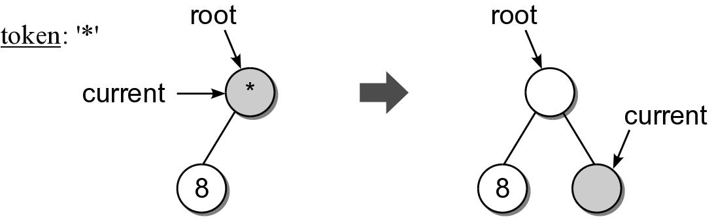
Expression Tree Construction
When an operator is encountered: (8*5)
the data field of the current node is set to the operator.
a new node is created and linked as the right child of the current node.
descend down to the new node.

Slide 10
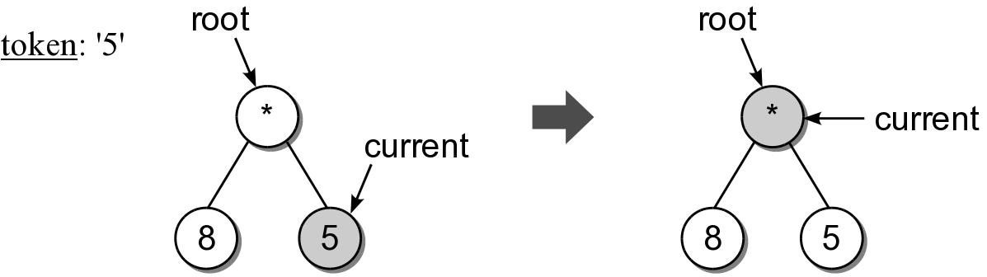
Expression Tree Construction
Another operand is encountered: (8*5)

Slide 11
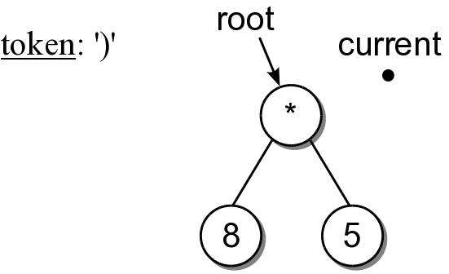
Expression Tree Construction
When a right parenthesis: (8*5)
move up to the parent of the current node.

Slide 12
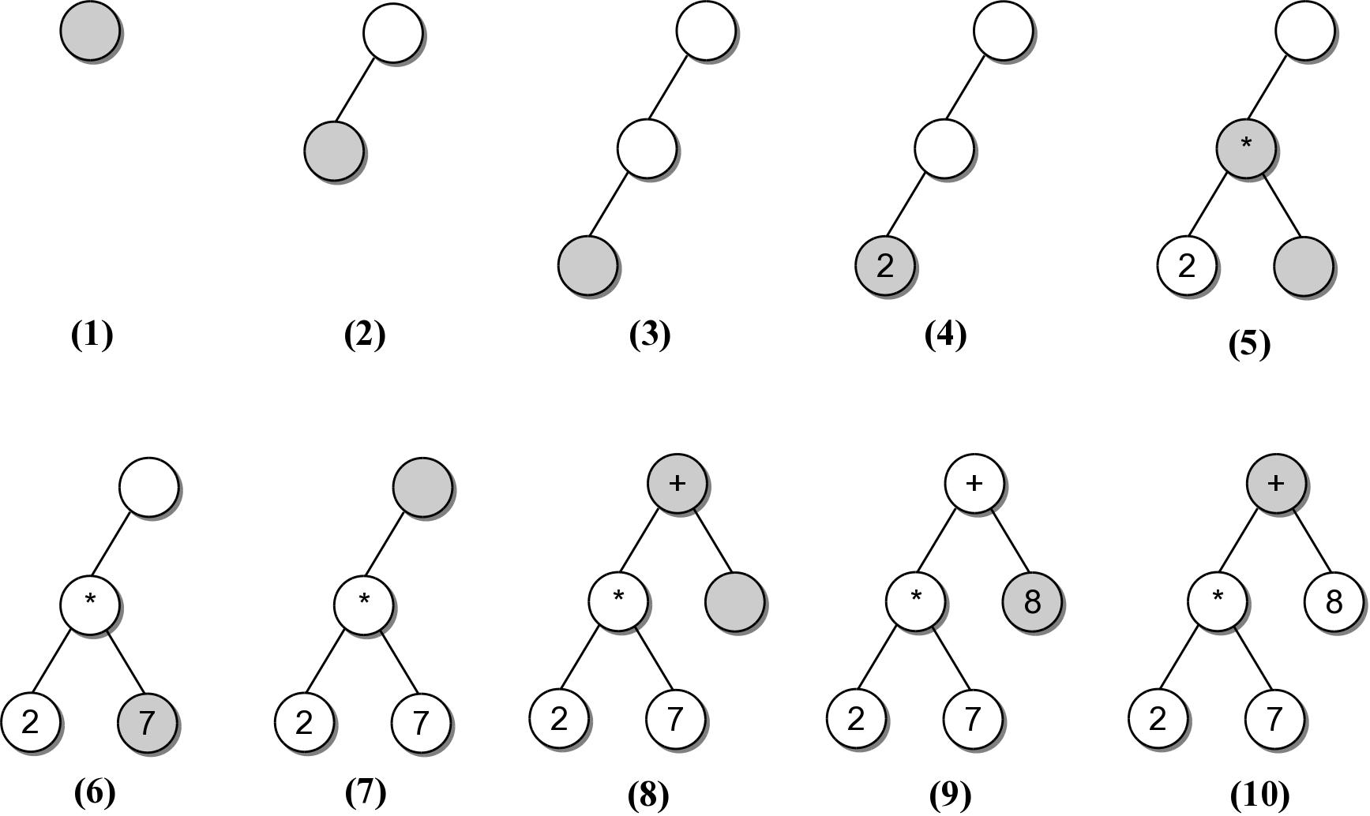
Expression Example #2
((2*7)+8)
Consider another expression:

Slide 13
Expression Tree Implementation
exptree.py
class ExpressionTree :
# ...
def _build_tree( self, exp_str ):
# Build a queue containing the tokens from the expression.
expQ = Queue()
for token in exp_str :
expQ.enqueue( token )
# Create an empty root node.
self._exp_tree = _ExpTreeNode( None )
# Call the recursive function to build the tree.
self._rec_build_tree( self._exp_tree, expQ )

Slide 14
Expression Tree Implementation
exptree.py
class ExpressionTree :
# ...
def _rec_build_tree( self, cur_node, expQ ):
# Extract the next token from the queue.
token = expQ.dequeue()
# See if the token is a left paren: '('
if token == '(' :
cur_node.left = _ExpTreeNode( None )
build_treeRec( cur_node.left, expQ )
# The next token will be an operator: + - / * %
cur_node.data = expQ.dequeue()
cur_node.right = _ExpTreeNode( None )
self._build_tree_rec( cur_node.right, expQ )
# The next token will be a ), remove it.
expQ.dequeue()
# Otherwise, the token is a digit.
else :
cur_node.element = token
Run testexptree.py in 28_ExpressionTree/

Slide 15
Heaps
A heap is a complete binary tree in which the nodes are organized based on their data values.
heap order property – how the nodes in a heap or arranged.
heap shape property – as a complete binary tree.

Slide 16
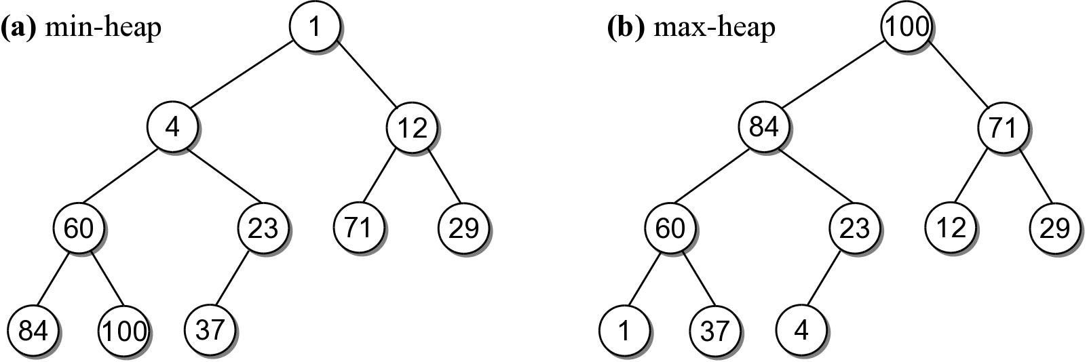
Heap property, examples
For each non-leaf node V,
max-heap: the value in V is greater than the value of its two children.
min-heap: the value in V is smaller than the value of its two children.

Slide 17
Heap Operations
The heap is a specialized structure with limited operations.
Insert an element into the heap.
Remove the element from root node.

Slide 18
Heap Operations
The heap is a specialized structure with limited operations.
Insert an element into the heap.
Remove the element from root node.

Slide 19
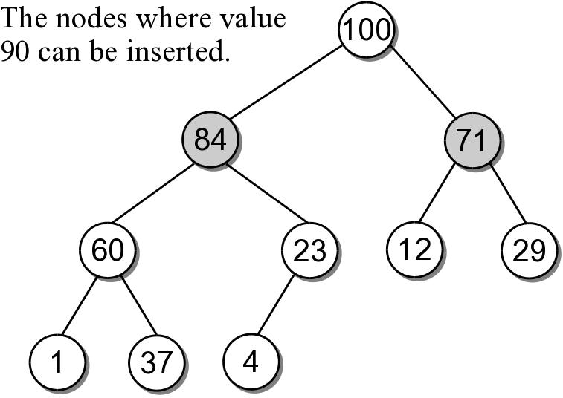
Heap Insertions
When an element is inserted into a heap, both properties must be maintained.
Example: add 90 to the max-heap.
There are only 2 places where 90 can be inserted.

Slide 20
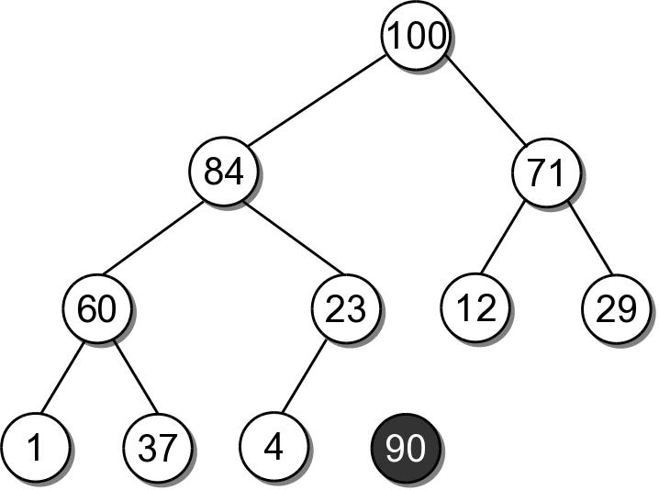
Heap Insertions
To properly insert an element into a heap involves several steps.
Create a new node for value.

Slide 21
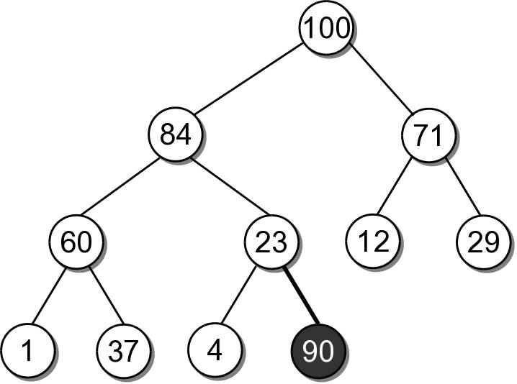
Heap Insertions
Link the node in as the last child in the complete tree.

Slide 22
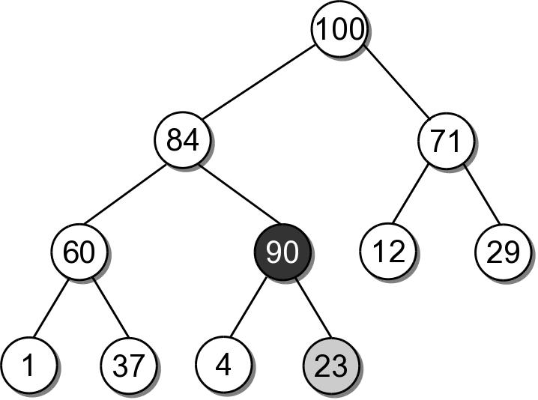
Heap Insertions
To restore the heap property, the new element has to move up along its path:
the data is swapped with its parent's data.
sift-up

Slide 23
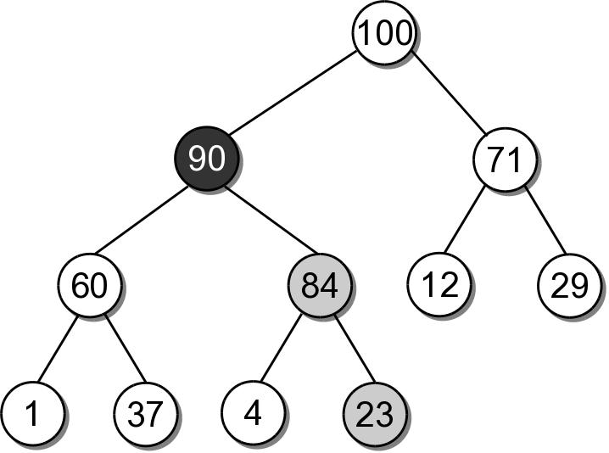
Heap Insertions
90 must move up another level since 84 is smaller.
After which, it is in it's correct position.

Slide 24
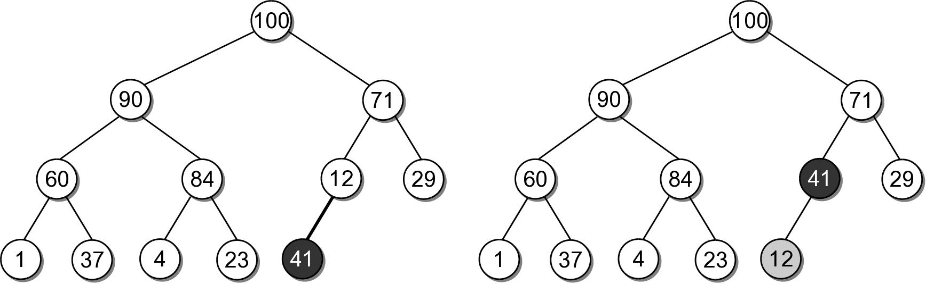
Heap Insert Example
Insert 41 into the heap from the previous slide.

Slide 25
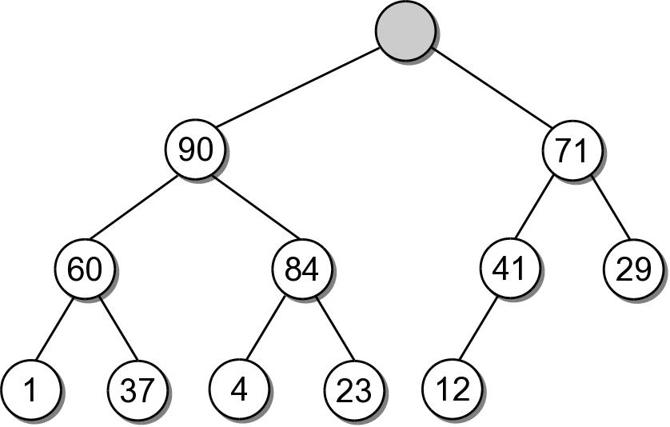
Heap Extractions
When an element is extracted from the heap, it can only come from the root node.
Both heap properties must be maintained.

Slide 26
Heap Extractions
To restore the tree to a heap:
another value will have to take the place of the extracted value in the root node.
a node has to be removed from the tree.

Slide 27
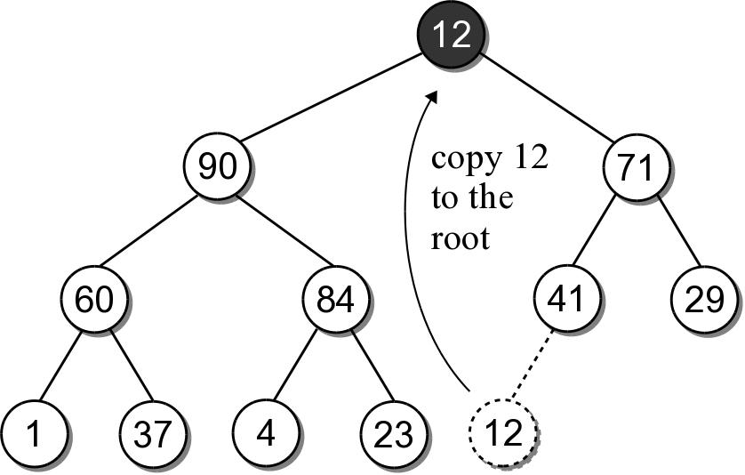
Heap Extractions
There is only one node that can be removed and still maintain the heap shape property.
Copy the data from the last child node to the root.
Delete the last child node.

Slide 28
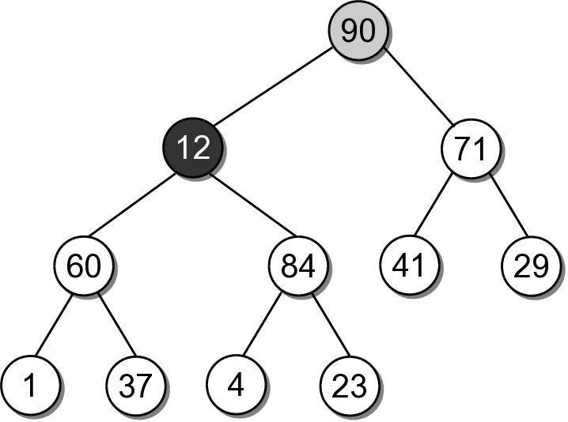
Heap Extractions
To maintain the heap order property, the new root value has to be sifted-down.

Slide 29
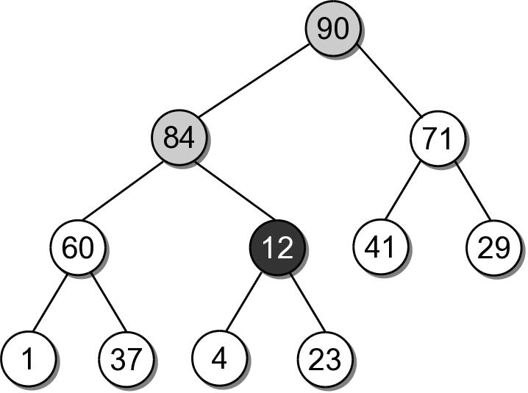
Heap Extractions
The shifting continues until the value is placed into a leaf node, or it is larger than its children.

Slide 30
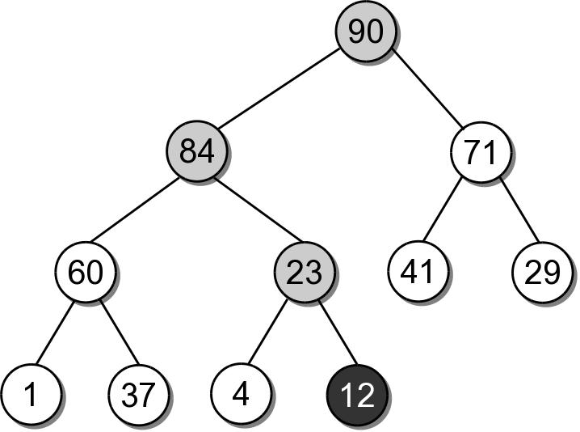
Heap Extractions
After being swapped with 23, value 12 will be in a node that maintains the heap order property.

Slide 31
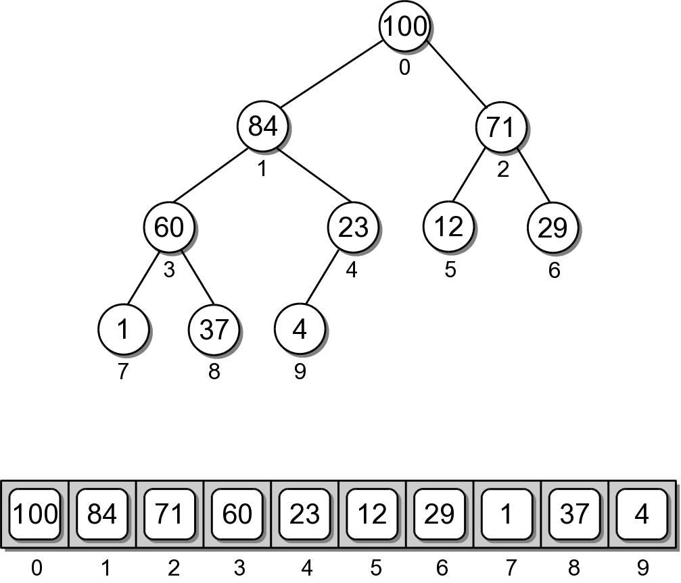
Heap Implementation
While a heap is a binary tree, it's seldom implemented as a dynamically linked structure.
Use a sequence to physically store the nodes.

Slide 32
Heap – Node Access
The complete tree will never contain “holes”.
The root will always be at position 0.
Its two children will always occupy positions 1 and 2.
The children of any node will always occupy the same position.

Slide 33
Heap – Node Access
Given the array index i
parent = (i-1) // 2
left = 2 * i + 1
right = 2 * i + 2
A child link is null if the index is out of range.

Slide 34
Heap – Class Definition
arrayheap.py
class MaxHeap :
def __init__( self, maxSize ):
self._elements = Array( maxSize )
self._count = 0
def __len__( self ):
return self._count
def capacity( self ):
return len( self._elements )
# ...

Slide 35
Heap – Class Definition
arrayheap.py
class MaxHeap :
# ...
def add( self, value ):
assert self._count < self.capacity(),
"Cannot add to a full heap."
# Add the new value to the end of the list.
self._elements[ self._count ] = value
self._count += 1
# Sift the new value up the tree.
self._sift_up( self._count - 1 )
def _sift_up( self, ndx ):
if ndx > 0 :
parent = ndx // 2
if self._elements[ndx] > self._elements[parent] :
tmp = self._elements[ndx]
self._elements[ndx] = self._elements[parent]
self._elements[parent] = tmp
self._sift_up( parent )

Slide 36
Heap – Class Definition
arrayheap.py
class MaxHeap :
# ...
def extract( self ):
assert self._count > 0,
"Cannot extract from an empty heap."
value = self._elements[0]
self._count -= 1
self._elements[0] = self._elements[ self._count ]
self._sift_down( 0 )
return value

Slide 37
Your Exercise
Following the pattern of function sift-up(), write the function sift-down() when the top (root) item is removed.

Slide 38
Heap – Class Definition
arrayheap.py
class MaxHeap :
# ...
def _sift_down( self, ndx ):
left = 2 * ndx + 1
right = 2 * ndx + 2
largest = ndx
if left < self._count and \
self._elements[left] >= self._elements[largest] :
largest = left
elif right < self._count and \
self._elements[right] >= self._elements[largest]:
largest = right
if largest != ndx :
self.swap( self._elements[ndx], self._elements[largest] )
self._sift_down( largest )

Slide 39
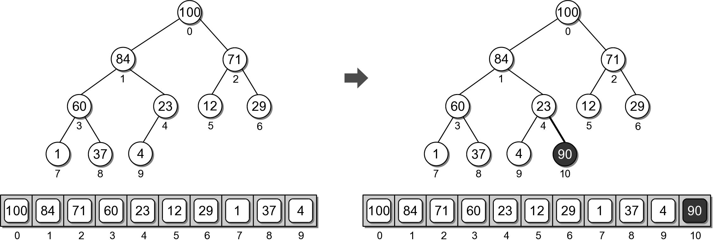
Heap Example
Physical view of adding value 90.

Slide 40
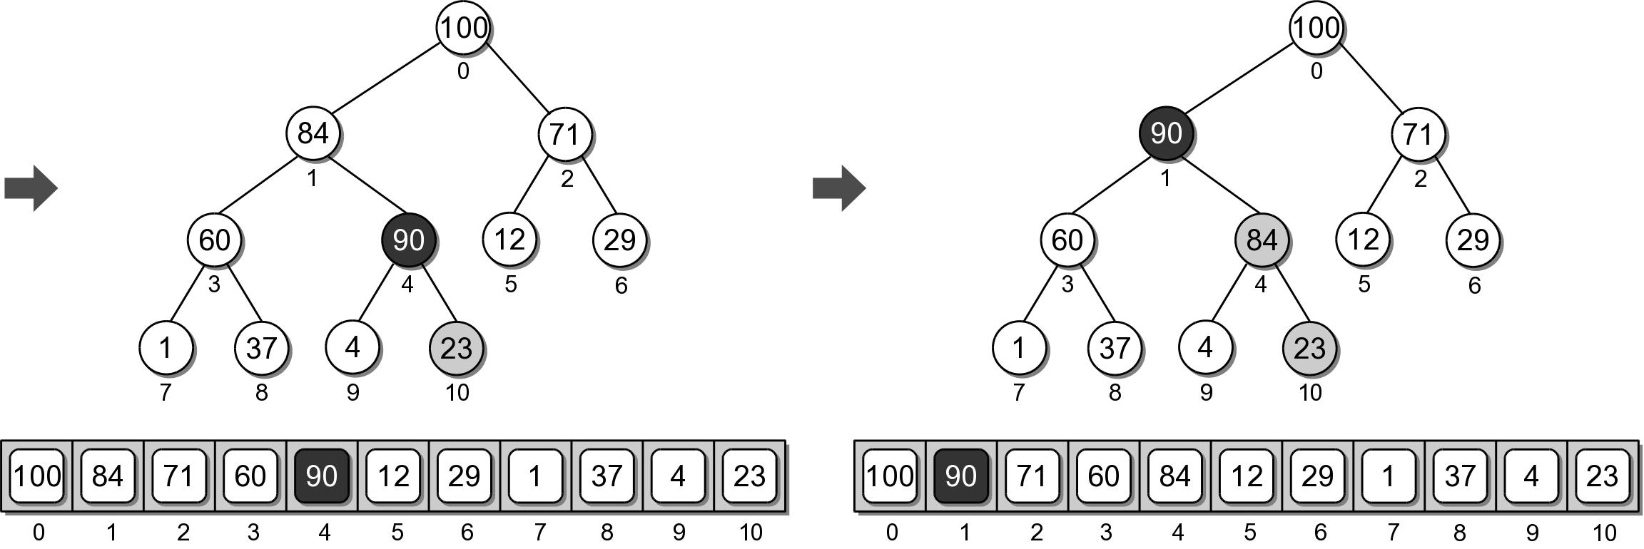
Heap Example
Physical view of adding value 90.

Slide 41
Heap Analysis
Assume a heap containing n elements:
Insertion: O(log n)
Extraction: O(log n)

Slide 42
The Heapsort
The simplicity and efficiency of the heap structure can be applied to the sorting problem.
Build a heap from a sequence of unsorted keys.
Extract the keys from the heap to create a sorted sequence.
Very efficient: O(n log n)

Slide 43
Heapsort Implementation
A simple implementation is provided below.
def simple_heap_sort( the_seq ):
# Create an array-based max-heap.
n = len(the_seq)
heap = MaxHeap( n )
# Build a max-heap from the list of values.
for item in the_seq :
heap.add( item )
# Extract each value from the heap and store
# them back into the list.
for i in range( n-1, -1, -1 ) : # small to large
# for I in range( n ) : # large to small
theSeq[i] = heap.extract()

Slide 44
The Heapsort
The simplicity and efficiency of the heap structure can be applied to the sorting problem.
Build a heap from a sequence of unsorted keys.
Extract the keys from the heap to create a sorted sequence.
Very efficient: O(n log n)

Slide 45
Heapsort Implementation
A simple implementation is provided below.
def simple_heap_sort( the_seq ):
# Create an array-based max-heap.
n = len(the_seq)
heap = MaxHeap( n )
# Build a max-heap from the list of values.
for item in the_seq :
heap.add( item )
# Extract each value from the heap and store
# them back into the list.
for i in range( n-1, -1, -1 ) : # small to large
# for I in range( n ) : # large to small
theSeq[i] = heap.extract()

Slide 46
In-Place Heapsort
The previous version required additional storage for the heap.
The entire process can be done in-place within the original sequence.
Suppose we are given the following array

Slide 47
In-Place Heapsort
The first step is to construct a max-heap.
The heap nodes occupy the array from front to back.
We can keep the heap elements in the front and those yet to be added at the back.
Keep track of where the heap ends.

Slide 48
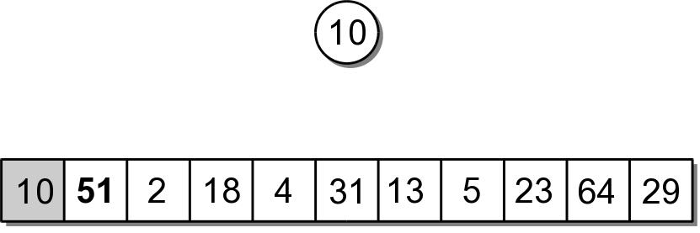
In-Place Heapsort
The first value in the array represents a max-heap of one element.

Slide 49
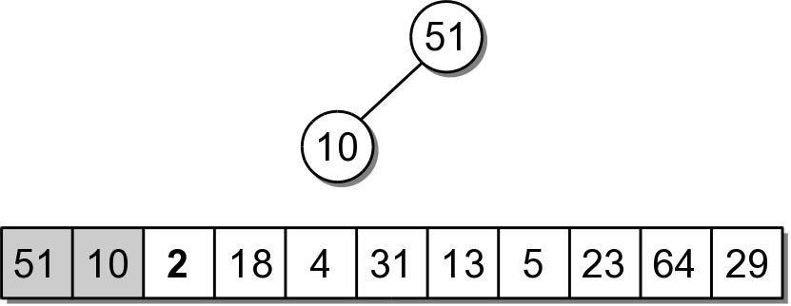
In-Place Heapsort
The next value to be added, is the next in the array.
The value is copied to the root node (position 0).
Then sifted down.

Slide 50
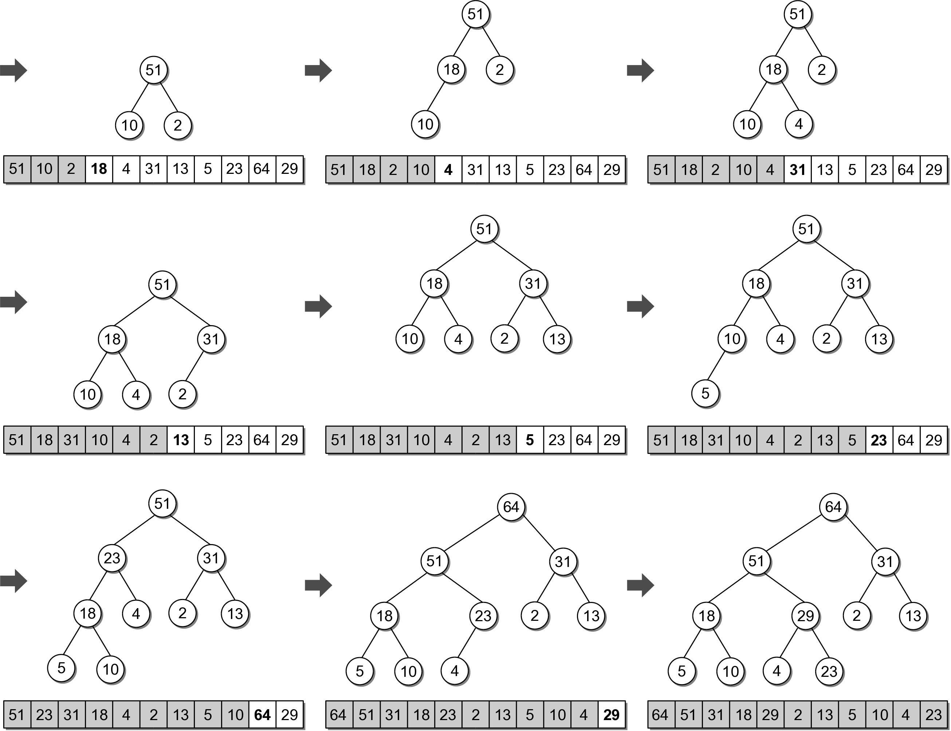
In-Place Heapsort

Slide 51
In-Place Heapsort
The next step is to extract the values from the heap and build the sorted sequence.
When the root is extracted, the last child node is copied to the root.
The last child node is stored in the last element of the heap.
We can simply swap the two values.

Slide 52
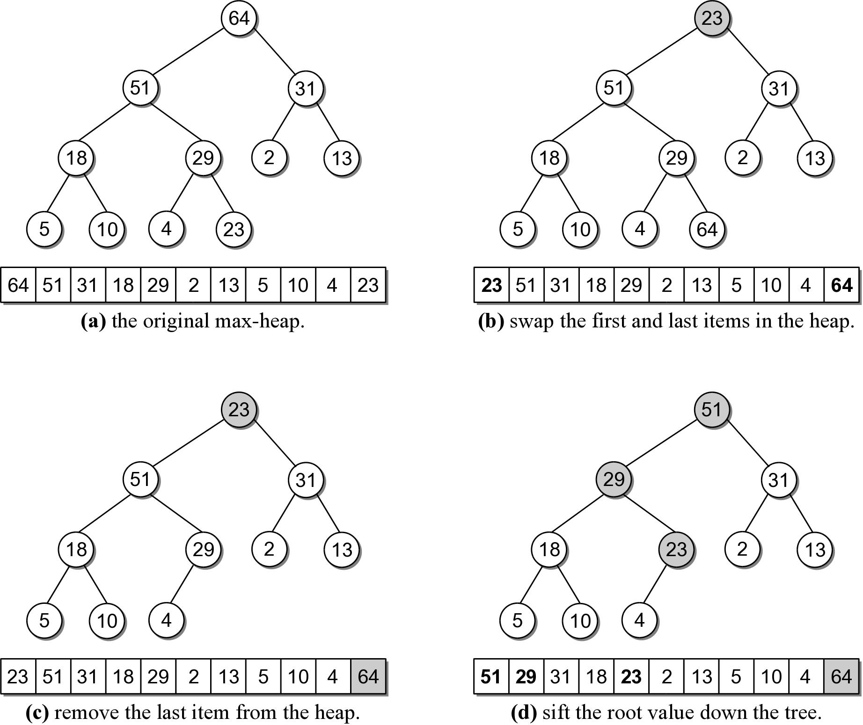
In-Place Heapsort

Slide 53
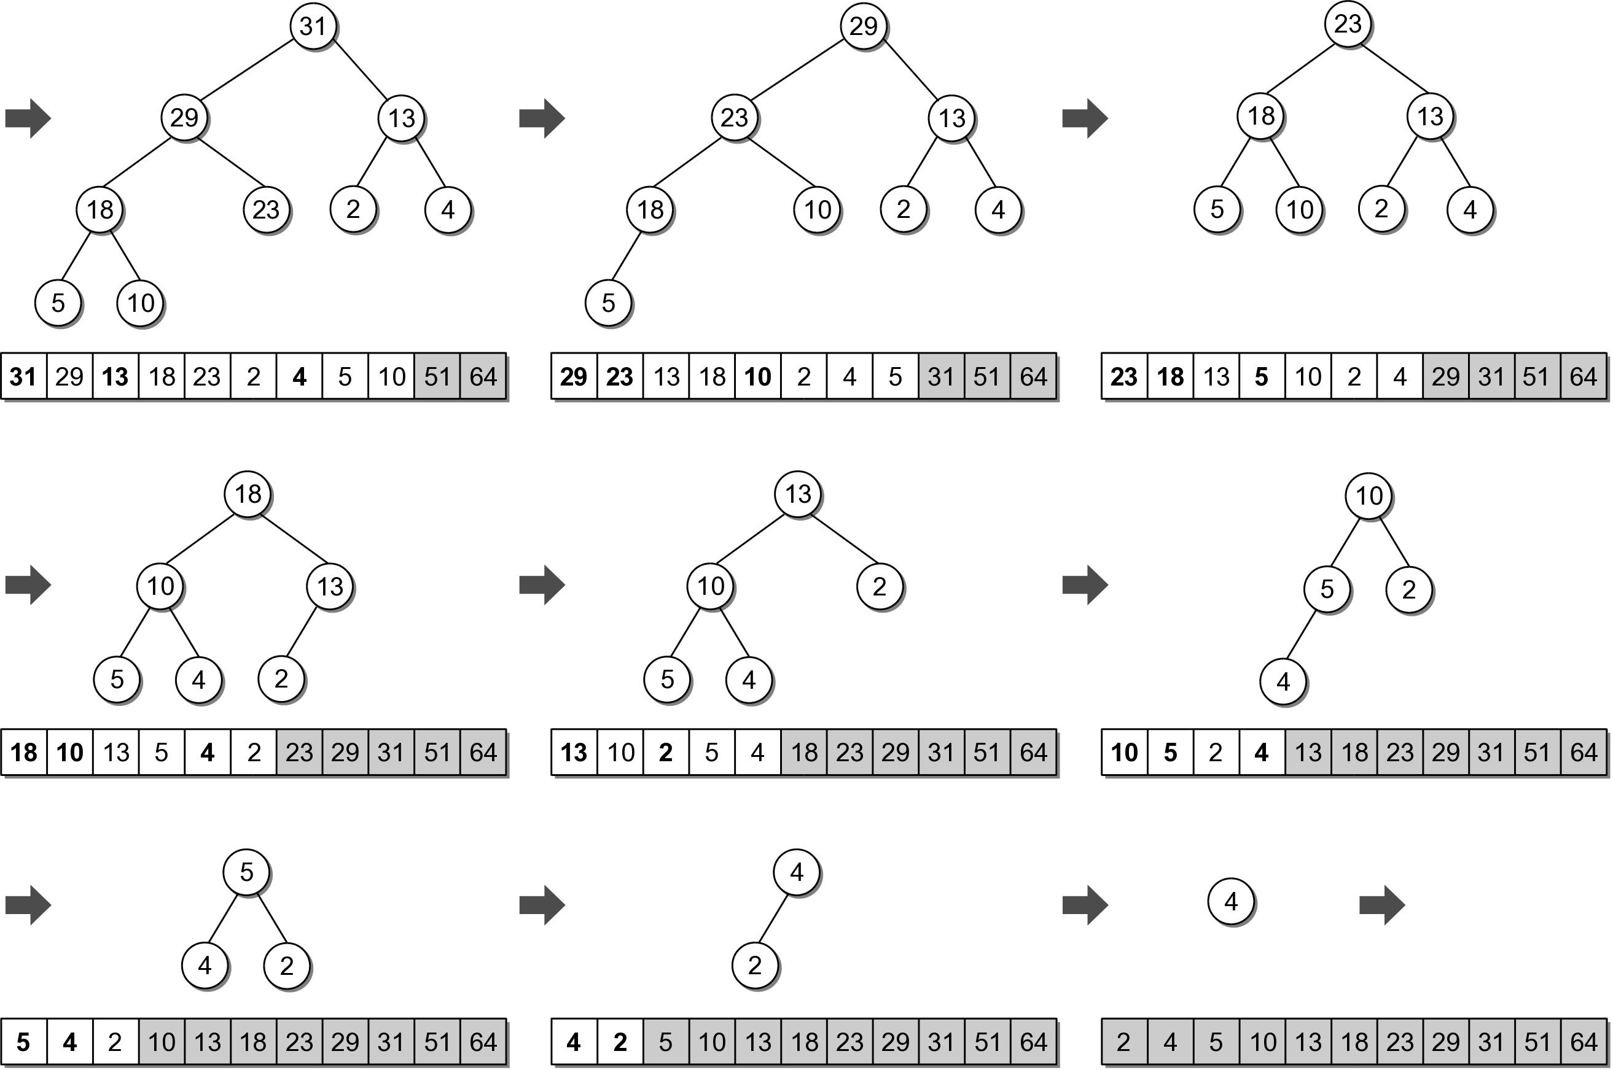
In-Place Heapsort

Slide 54
In-Place Heapsort Implementation
sift_up() and sift_down() are helper functions based on those used in the heap class.
def heapsort( the_seq ):
n = len(the_seq)
# Build a max-heap within the same array.
for i in range( n ) :
siftUp( the_seq, i )
# Extract each value and rebuild the heap.
for j in range( n-1, 0, -1) :
tmp = the_seq[j]
the_seq[j] = the_seq[0]
the_seq[0] = tmp
siftDown( the_seq, j-1, 0 )
Try heapsort.py

